Slide 1
Voice Emotion
Detection
Submitted by : -
N180726 – B.Idris
N180530 – K.Neeraja
N180241 – D.Karthik
N180253 – M.Althaf Ahmad
N180490 – S.Manjulatha
Guided by :-
Ms. M. Baby Anusha

Slide 2

Abstract :-
Communication is the key to express one’s thoughts and ideas clearly. Amongst all forms of communication, speech is the most preferred and powerful form of communication in humans. We focus on studying emotions’ recognition from speech and audio-visual input and show the different techniques of deploying these algorithms in the real world. These emotion recognition techniques can be used as a surveillance system in healthcare centers to monitor patients Voice emotion recognition is a technology that extracts emotion features from computer speech signals, compares them, and analyses the feature parameters and the obtained emotion changes. Recognizing emotions from audio signals requires feature extraction and classifier training. This creates the necessity for these computer applications to completely comprehend human speech. A speech percept can reveal information about the speaker including gender, age, language, and emotion. Most of the present work involves the utter

Slide 3
Introduction
One of the medium of interaction is speech. The main challenges in HCI(Human Computer Interaction) is detection of emotion from voice.
Emotion can be detected from different audio signals. Recognizing emotions from audio signals require feature extraction and classifier training.

Slide 4

Motivation
As we seen in the introduction HCI playing a role in voice emotion detection let see an application based on voice emotion detection. Self-driving cars are one such application that controls many of its functions using voice-based commands Considering emergency situations in which the user may be unable to clearly provide a voice command, the emotion expressed through the user’s tone of voice can be used to turn on certain emergency features of the vehicle.

Slide 5
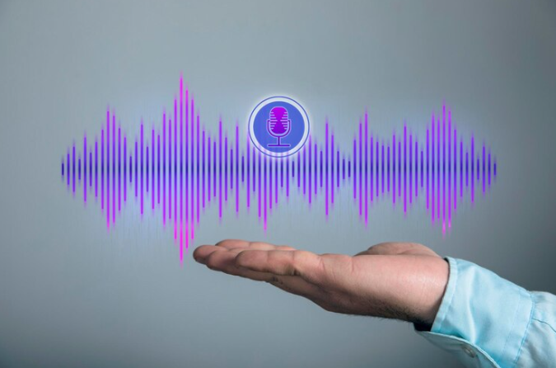

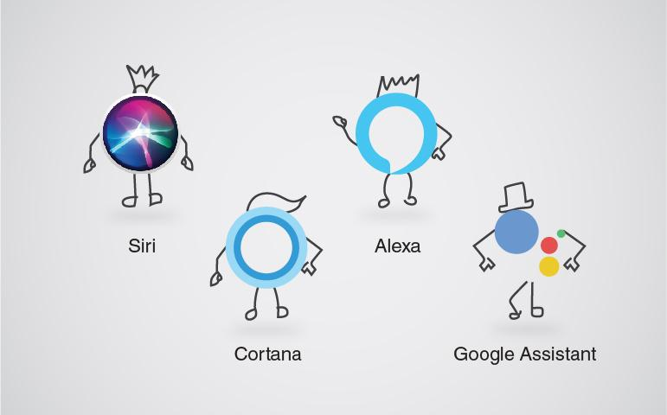
Applications
Call Centers
Voice Assistant

Slide 6

Existing System
The existing work in this area reveals the most of the present work relies on lexical analysis for emotion recognition, that have been used for the purpose of classification of emotions into three categories, i.e ..Angry , Happy and Neutral. The maximum cross correlation between the discrete time sequences of the audio signals is computed and the highest degree of correlation between the testing audio file and the training audio file is used as an integral parameter for identification of a particular emotion type.
The second technique is used with the feature extraction of discriminatory features with the cubic SVM classifier for recognition of Angry, Happy and Neutral emotions segments only.

Slide 7

Limitations in existing system
The system is very static in nature and can’t provide any good performance in real time systems.
Variable length audio files are not understandable.
Long preprocessing steps are required for the model to understand the audio signals.
Expensive and not upgradable.

Slide 8
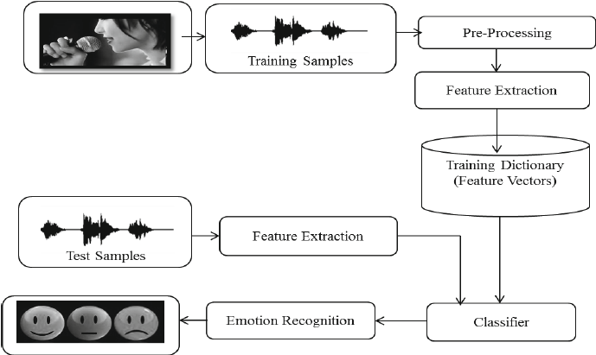
Architecture of the System

Slide 9
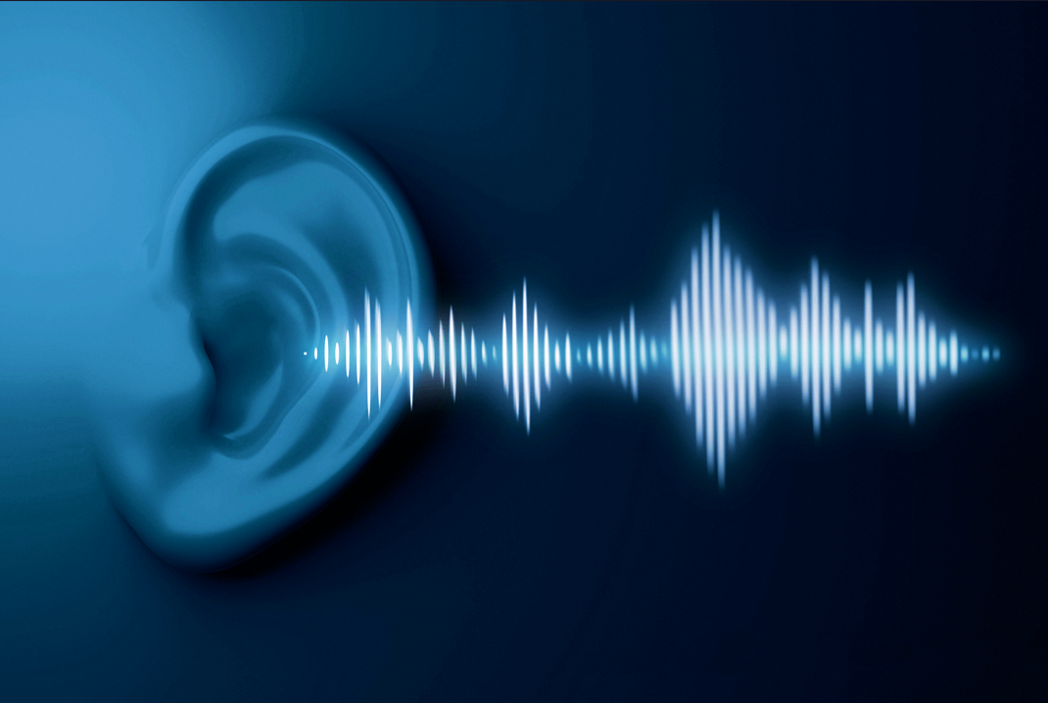
Components in proposed system
Preprocessing :- The process of preparing the raw data and make it suitable Machine Learning models.
Training Data: It is labeled data used to teach ML algorithm to make proper decisions
Test Data: It is a set of data used to test how the model works after training is complete.
Feature Extraction:- The process of transforming raw data into numerical features.
Training Dictionary(feature vector): It is a set of multiple numeric features. We use it as an input to the machine learning model for training and prediction purposes.
Classifier :- It is an alogrithm used in ML because they map the input into predefined categories, making the process easier for the user.
Emotion Recognition: Process of identify the Human emotion.

Slide 10

Algorithm
The Long-Short Term Memory (LSTM) is another model for classifying speech data. This is also defined as sequential. Adam optimizer and softmax activation function is used for reduced overfitting. Loss is calculated by categorical_crossentrophy. The batch size is 16. The pseudo-code of the LSTM model is :
Notations:
In = Input,
N = Number of neurons for this
model,
E = Repeat/Epochs
Pseudocode 2:
1. procedure LSTM (In, N, E)
Import library and datasets
2. Input Dataset with variable combinations.
Training LSTM
3. for In = 1 to End of input do
4. for N = 1 to 256 do
5. for E = 1 to 200 do
6. Add Softmax
7. Train LSTM
8. end for
9. end for
10. end for
11. return LSTM-metrics
12. end procedure

Slide 11
Required Libraries
import pandas as pd
import numpy as np
import os
import librosa
import librosa.display
import tensorflow
import keras
import seaborn as sns
import matplotlib.pyplot as plt
from IPython.display import Audio
Import warnings
Warnings.filterwarnings(‘ignore’)
Conda update wrapt
Pip install tensorflow-gpu==1.14

Slide 12
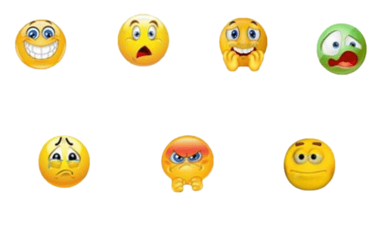
Datasets
RAVADEES
TESS
SAVEE

Slide 13
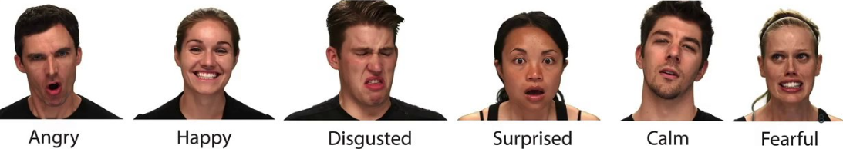
TESS Dataset
Toronto Emotional Speech Set (TESS) dataset.
TESS dataset contains of at most 2800 audio files in WAV format.
The TESS Dataset is a collection of audio clips of 2 women expressing 7 different emotions

Slide 14

System Specifications
Hardware:
Processor : CORE i3
RAM : 4 GB or Higher
ROM : 100 GB or Higher
OS : Windows 8 or high
Software:
PYTHON
Jupyter Notebook
Google colab
PyCharm
.

Slide 15
Waveforms
SAD
PS
NEUTRAL
HAPPY
FEAR
ANGRY
DISGUST
.

Slide 16
Extracted Features
SAD
PS
FEAR
DISGUST
NEUTRAL
HAPPY
ANGRY
.

Slide 17
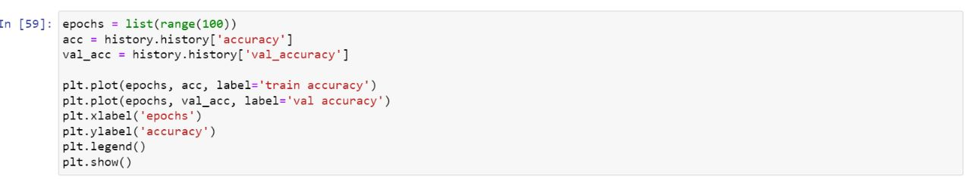
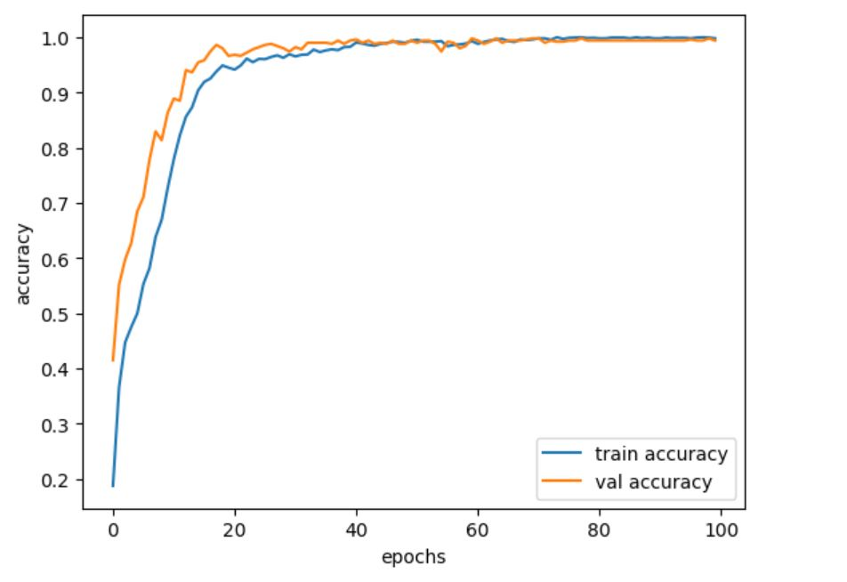
Accuracy

Slide 18
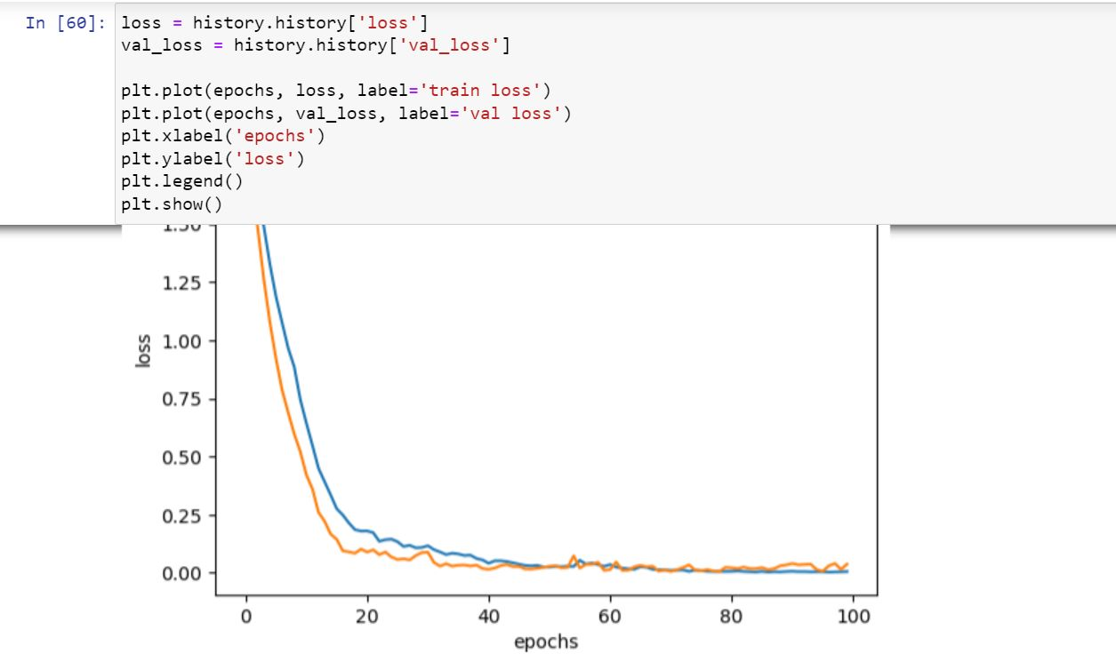
Continue

Slide 19
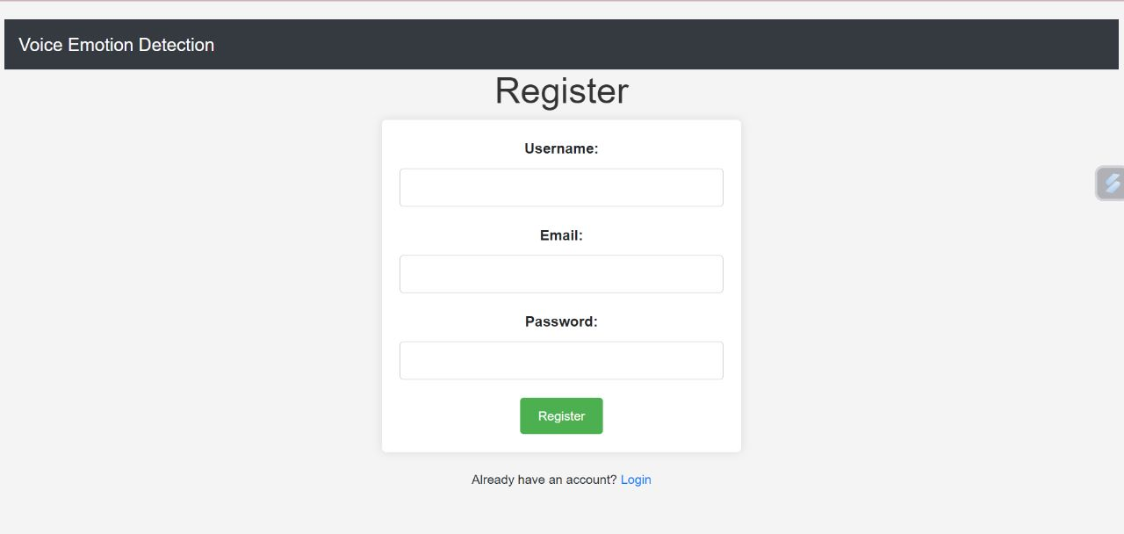
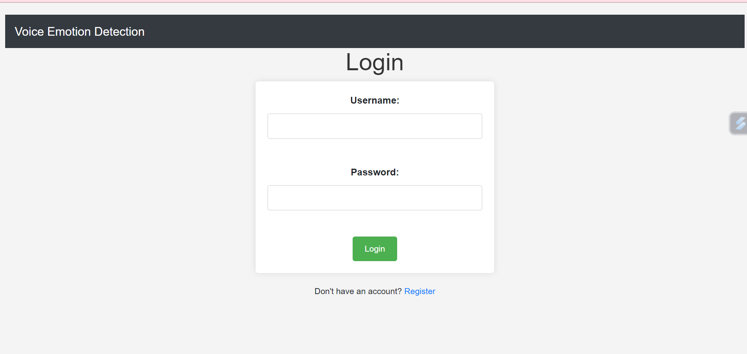
Register Page
Login Page
1.At first user will register into website by giving Username , Password & email
2.After Registration User Login into website by giving username & Password to enter into main page

Slide 20
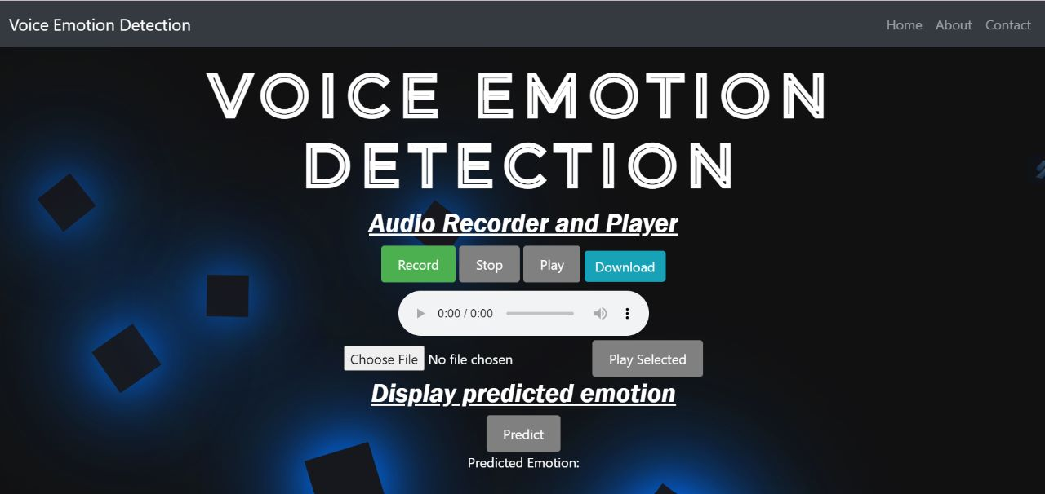
User Interface Website
Main page – By click on choose file user will add audio file, then click on play selected
Button after that click on predict button. The output show in the Predict emotion so on so

Slide 21
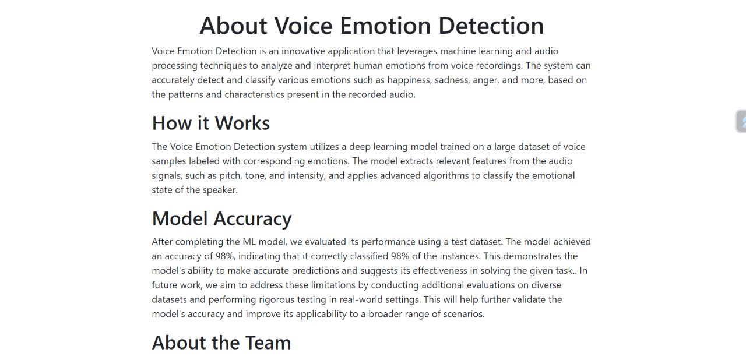
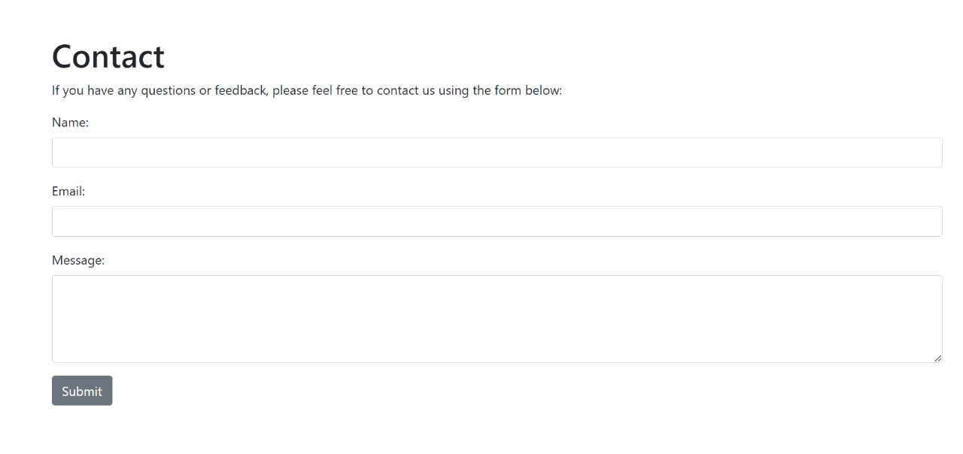
About Page
Contact Page
About page describes about what is voice
Emotion detection, how it works, model accuracy and about team members
Contact page describes for any help or feedback
By giving details like name, email and feedback
Or problem message and then click on submit button

Slide 22
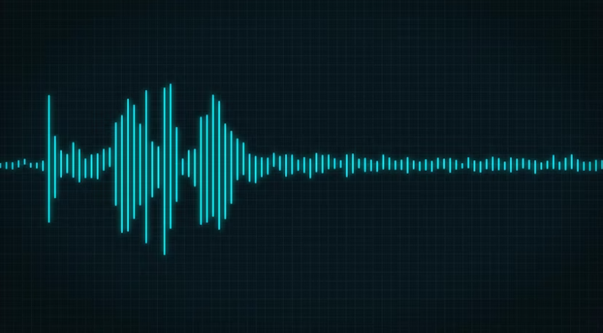






Predicted Emotion

Slide 23

Conclusion
The proposed model achieved an accuracy of 98.9%
Happy was the best identified emotion.

Slide 24
Future Scope
Our future scope is to recognizing the patient's emotions using deep learning techniques. Automatically identifying the emotions can help build smart healthcare centers that can detect depression and stress among the patients in order to start the medication early. We focus on studying emotions' recognition from speech and audio-visual input and show the different techniques of deploying these algorithms in the real world. These two emotion recognition techniques can be used as a surveillance system in healthcare centers to monitor patients. We conclude the survey with a presentation of the challenges and the related future work to provide an insight into the applications of using emotion recognition.

Slide 25
References
[1] Dsp.stackexchange.com. (2018). Framing an audio signal. [online] Available at:https://dsp.stackexchange.com/questions/27243/framing-an-audio-signal.
[2] Giannakopoulos, T. (2018). pyAudioAnalysis. [online] GitHub. Available at:https://github.com/tyiannak/pyAudioAnalysis
[3] B. Liu, H. Qin, Y. Gong, W. Ge, M. Xia, and L. Shi, „„EERA-ASR: An energy- efficient reconfigurable architecture for automatic speech recognition with hybrid DNN and approximate computing,‟‟ IEEE Access, vol. 6, pp. 52227– 52237, 2018
[4] N. Cummins, S. Amiriparian, G. Hagerer, A. Batliner, S. Steidl, and B. W. Schuller, „„Animage based deep spectrum feature representation for the recognition of emotional speech,‟‟ in Proc. 25th ACM MultimediaConf. (MM), 2017, pp. 478–484.
[5] T. Hussain, K. Muhammad, A. Ullah, Z. Cao, S. W. Baik, and V. H. C. de Albuquerque, „„Cloud-assisted multiview video summarization using CNN and bidirectional LSTM,‟‟ IEEE Trans. Ind. Informat., vol. 16, no. 1, pp. 77–86,Jan. 2020

Slide 26


